Slide 1
Personalization via reinforcement learning The Azure personalization service
June 27, 2019
Azure Machine learning meetup
https://www.meetup.com/New-York-Azure-Machine-Learning-Meetup/
https://github.com/jimwill3/NY-AZML-Meetup/tree/CNTK/RL
msevent911dn

Slide 2

What is the personalization service
Reinforcement learning–based capability through a REST API
Personalized experiences for every user/scenario of your app
Prioritize relevant content and user experiences
Large scale and high volume design targets
Based on the Decision Service work done earlier
https://docs.microsoft.com/en-us/azure/cognitive-services/custom-decision-service/
https://docs.microsoft.com/en-us/azure/cognitive-services/personalizer/

Slide 3



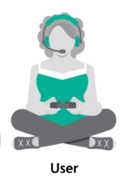
Can we optimize for the best outcome?
Amongst a given set of choices?
For what matters to you?
Without self-fulfilling prophecies?
With real-time learning?
In a transparent way?
Self-tuning for best perf?

Slide 4

Reinforcement learning supports this
Action
Policy ?
Observation
Reward
Goal: Find a policy maximizing the sum of rewards

Slide 5
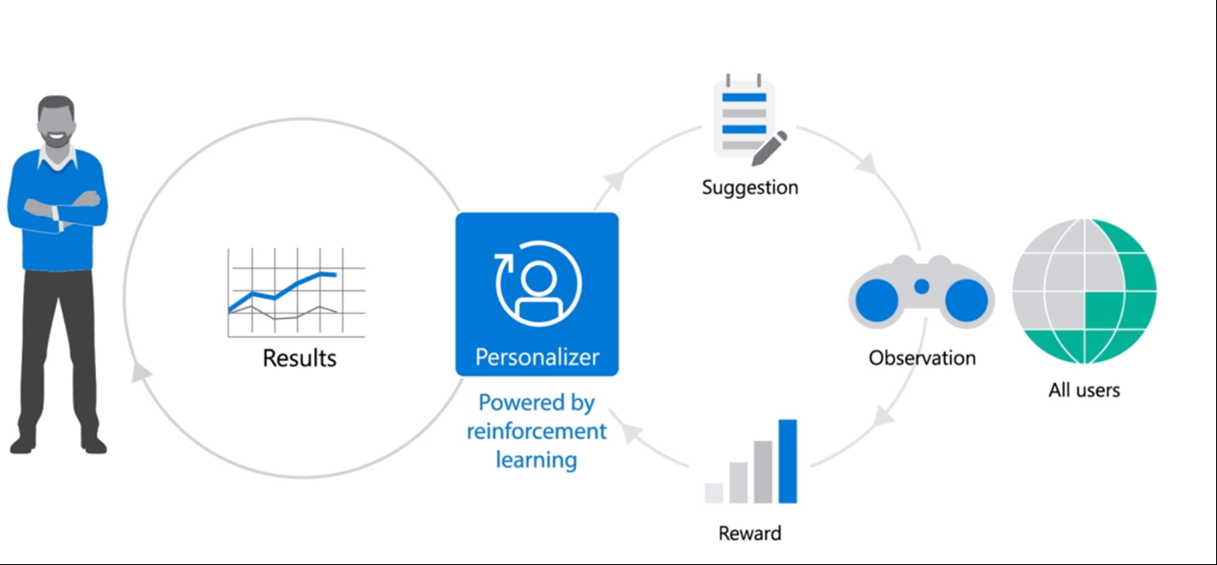
Personalizer in context

Slide 6






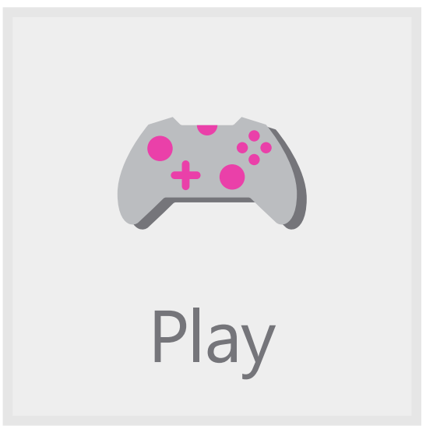
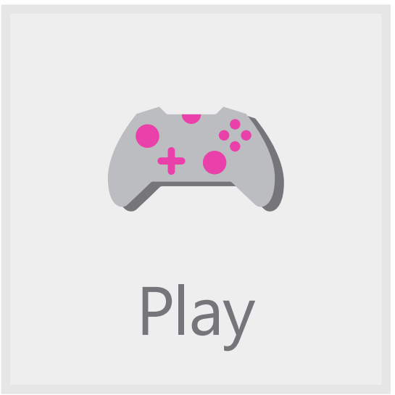








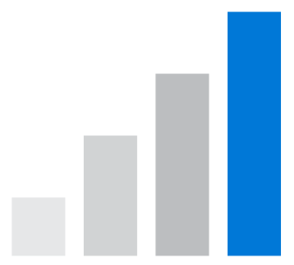
Example…
Your app
User & Context Info
Have Fun!
We think you’ll like…
Action 1 info
?
Action 2 info
Rank(..)
Personalizer service
Reward(r)
Your users
Action 3 info
Your business logic observing & evaluating user behavior
Reward score

Slide 7
Your APP FLOW
App context(user+device
+timeofday…)
App Feature/action
(sports, politics,science…)
App Invoke Personalizer API
App Calculate Reward
[ -1 to +1]
App Update Personalizer with Reward
(call API with reward)
API
Engine
Config
Personalizer Service

Slide 8
What do I need
Personalizer works with attributes you have about users, content, and products, without data manipulation.
Personalizer is available:
in the cloud or
as a microservice running locally, where low latency is critical
A JSON object supplied in code describes the properties and attributes your application determines to be relevant to personalization
Your code invokes an Azure REST API and receives a ranked list of options (actions)
Your code then provides feedback to the service based on the behavior associated with the action chosen

Slide 9
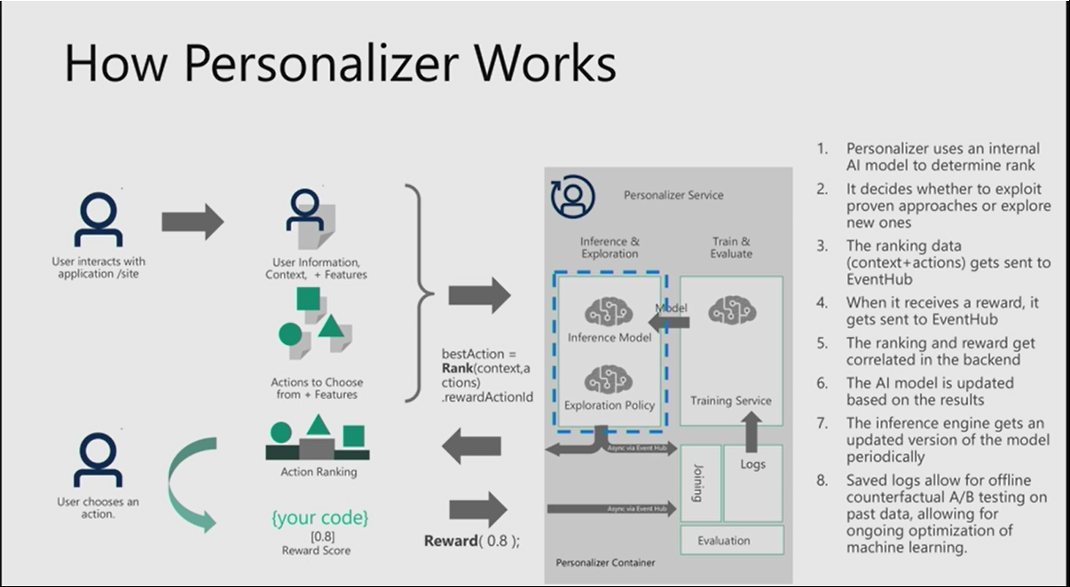
HOW IT WORKS (IMPLEMENTED IN VOWPAL WABBIT TODAY
The current version of Personalizer uses contextual bandits, an approach to reinforcement learning that is framed around making decisions or choices between discrete actions, in a given context

Slide 10
Let’s look at sample problem & code
Problem: recommend a coffee like beverage to individuals
You have no history about the individual but each message (state) provides their name, weather, timeofday along with a set of possible beverages.
Pass that info into the Personalizer Service, which returns an action (beverage) to choose.
“offer” that beverage and if the person “accepts” a +1 reward is sent back to the service, a 0 reward if the person does not “accept”

Slide 11
What to send to personalizer
Context – (the state and context) for example
'contextFeatures': [{'timeofday': 'Morning', 'weather': 'Sunny', 'name': 'Bob’}]
‘action features’ (the options to choose from and key features)
actions': [{'id': 'Cappucino', 'features': [{'type': 'hot'}]}, {'id': 'Cold brew', 'features': [{'type': 'cold'}]}, {'id': 'Iced mocha', 'features': [{'type': 'cold'}]}, {'id': 'Latte', 'features': [{'type': 'hot’}]}
Note: there are 4 choices in this request (choices can vary by request)

Slide 12
How to send /receive to personalizer
response = requests.post(personalization_rank_url, headers = headers, params = None, json = rankjsonobj)
Rankjsonobj contains the previously described context And action/feature json
Fetching the service’s proposed action:
prediction = json.dumps(response.json()["rewardActionId"]).replace('"',‘’)
Prediction:Latte for Name:Bob Weather:Rainy timeMorning
{'ranking': [{'id': 'Latte', 'probability': 0.8874999}, {'id': 'Cappucino', 'probability': 0.0374999978}, {'id': 'Iced mocha', 'probability': 0.0374999978}, {'id': 'Cold brew', 'probability': 0.0374999978}], 'eventId': '9a6d7aa3439d4d4582f186f46ea572ba', 'rewardActionId': 'Latte'}

Slide 13
How does it work
reinforcement-learning cycle learns in real time from your end users’ interactions and helps you improve the user experience to achieve your business goals.
Personalizer returns its suggested action in a ranked list)
Personalizer supports model explainability, reproducibility of results, and ongoing evaluation of its effectiveness for added transparency.

Slide 14

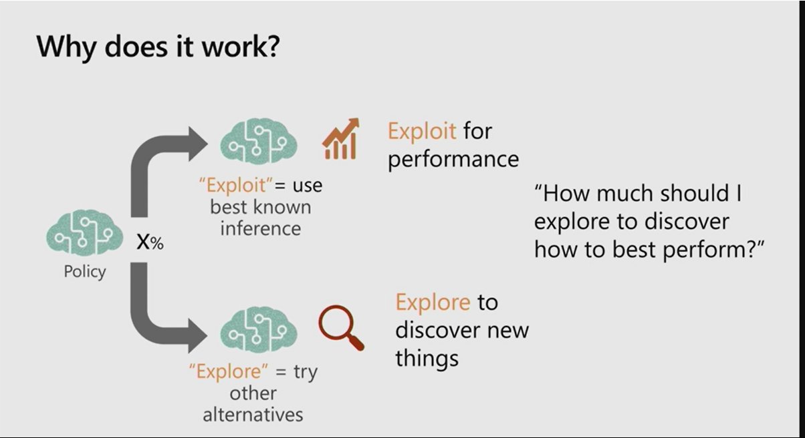
Configuration Choice Exploration rate
This may look familiar to earlier sessions where we hand coded a simple explore/exploit in python.
In Personalizer the explore/exploit ratio is stored in the models configuration section – available in the Azure portal

Slide 15
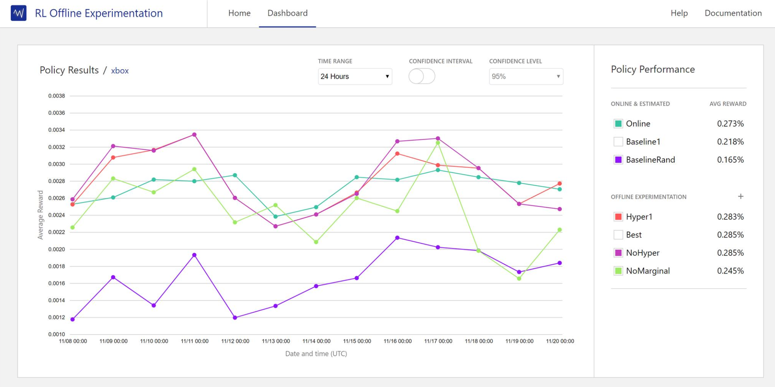
Why explore? You can do learning
Better learning policies discovered automatically
Personalizer current model
Your application’s baseline
Random

Slide 16
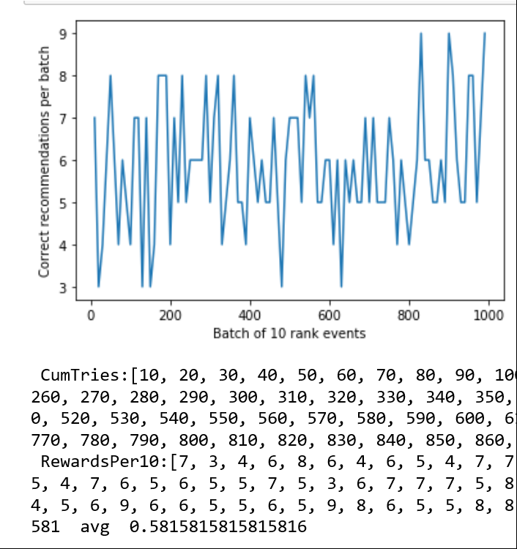
Sample output (small try – 1000 events)
Note the improvement in the last 200 or so events – rewards are trending up
totlast200: 108 last200avg: 0.60
Note: this is a forced example since I kept the feature set frozen – reducing complexity

Slide 17
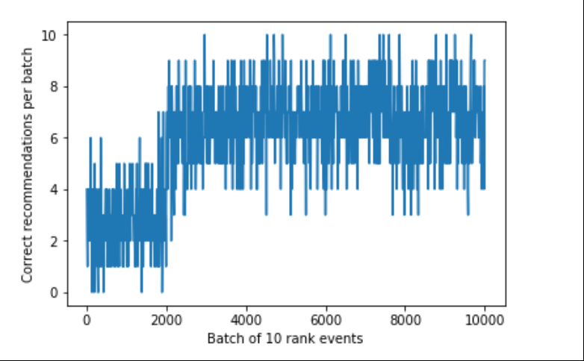
Ideally – results should look like this (sample code from product team on github)
Form the beverage selection sample Jupyter notebook
https://github.com/Azure-Samples/cognitive-services-personalizer-samples/blob/master/samples/azurenotebook/Personalization.ipynb

Slide 18
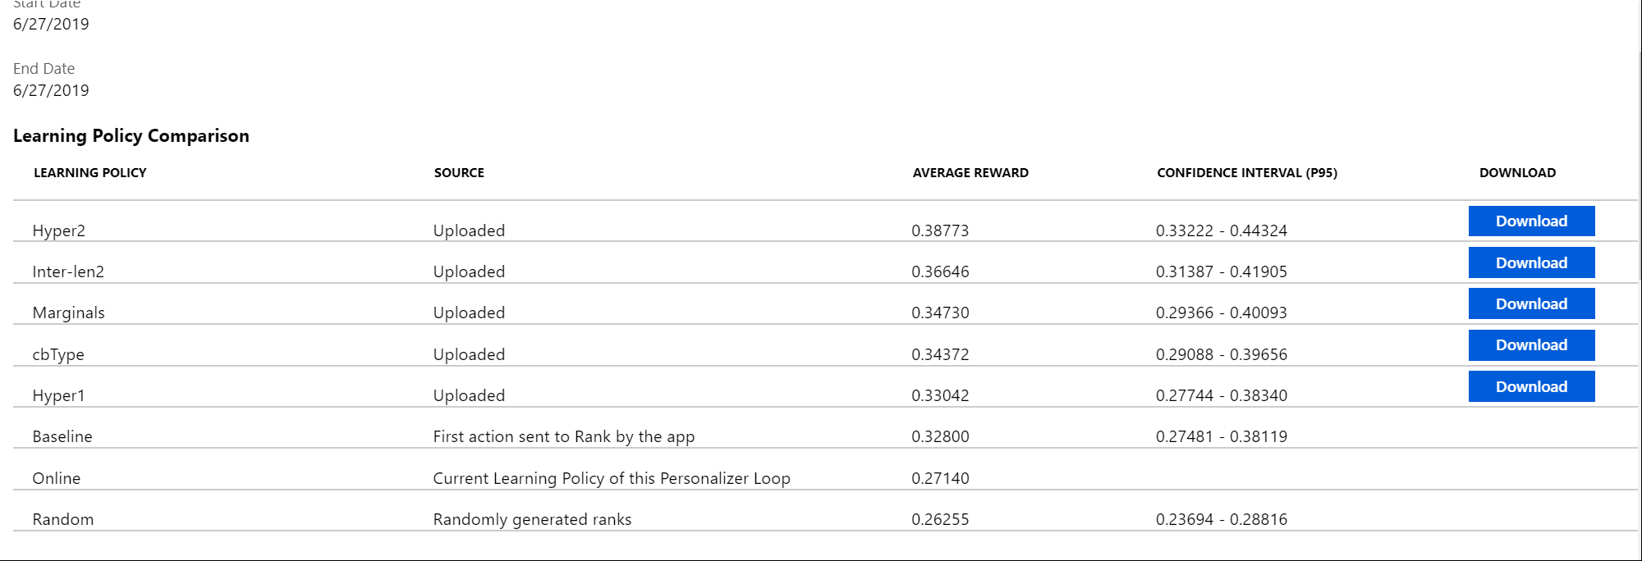
Evaluations can help find better policy
This evaluation was run right after the previous results chart was produced.

Slide 19
2000 events
Full run: avg 0.585
last200avg: 0.711
Run the evaluation – take best policy and load that back into the current policy and run again:
Full run avg 0.732
last200avg: 0.680
Boost from 0.585 to 0.732 – no code changes – just load the best policy

Slide 20
Actions represent a list of options
Each action:
Has an ID.
Has a list of features (hot, politics, thriller…)
The list of features can be large (hundreds) but we recommend evaluating feature effectiveness to remove features that aren't contributing to getting rewards.
The features in the actions may or may not have any correlation with features in the contextused by Personalizer.
Features for actions may be present in some actions and not others.
Features for a certain action ID may be available one day, but later on become unavailable.
Do not send in more than 50 actions when Ranking actions. These may be the same 50 actions every time, or they may change

Slide 21
{ "contextFeatures": [ { "user": { "name":"Doug" } }, { "state": { "timeOfDay": "noon", "weather": "sunny" } },
Information for the context depends on each application and use case, but it typically may include information such as:
Demographic and profile information about your user.
Information extracted from HTTP headers such as user agent, or derived from HTTP information such as reverse geographic lookups based on IP addresses.
Information about the current time, such as day of the week, weekend or not, morning or afternoon, holiday season or not, etc.
Information extracted from mobile applications, such as location, movement, or battery level.
Historical aggregates of the behavior of users - such as what are the movie genres this user has viewed the most.

Slide 22
Good features
There are enough features to drive personalization
There are enough features of diverse densities. A feature is dense if many items are grouped in a few buckets
For example, a timestamp down to the second is a very sparse feature. It could be made more dense (effective) by classifying times into "morning", "midday", "afternoon", etc.

Slide 23
General notes
Context Features should be dense – sparse features (timestamps) are too fine grained but time of day (hour or AM/PM etc. are denser)
Action Features should be modest in size but can vary over time. They should have some density (movies by category but not movies by title)
Don’t send null Actions – exclude them explicitly if they cannot be acted upon – the schema supports this)
Don’t expect low volume learning – the model has to bootstrap itself and may need thousands of events/actions/rewards to learn
Evaluations cannot go back further than data retention – if you have a model that you expect to use for a week and evaluate then set retention correspondingly

Slide 24
What does a model look like when exported?
--cb_adf --cb_explore_adf --cb_type ips --csoaa_ldf multiline --csoaa_rank --epsilon 0.150000005960464 --quadratic Fi --quadratic
and some binary code….

Slide 25
What does an exported policy look like?
--cb K use contextual bandit learning with K costs
--cb K use contextual bandit learning with K costs
{ "name": "605ebd45e7294e24bac5ccb6506fbe14", "arguments": "--cb_explore_adf --epsilon 0.2 --dsjson --cb_type ips -q Fi -q Fj -l 0.5 --l1 1e-05 --power_t 0.5“
https://github.com/VowpalWabbit/vowpal_wabbit/wiki/Contextual-Bandit-algorithms

Slide 26
Questions? Thank you!
Azure Portal http://aka.ms/personalizer
Samples
https://github.com/Azure-Samples/cognitive-services-personalizer-samples
Feedback in UserVoice http://aka.ms/personalizer-uservoice
Research tutorial http://hunch.net/~rwil
Select Papers
https://arxiv.org/abs/1502.02206
https://arxiv.org/abs/1606.03966

Slide 27
extras

Slide 28


Policies
Policy maps features to actions.
Policy = Classifier that acts.

Slide 29
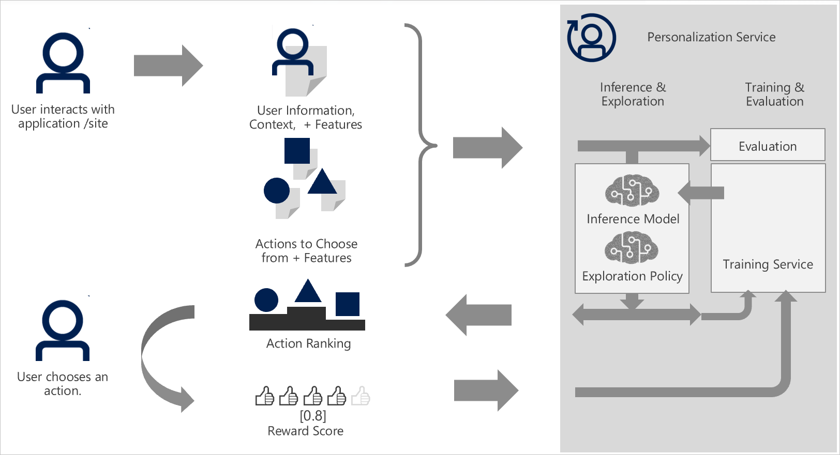

Slide 30
